Slide 1

INVENTORY MANAGEMENT SYSTEM
ELECTRONIC SHOP
Amrita Vishwa Vidyapeetham
Ettimadai 641112, Coimbatore, Tamil Nadu

Slide 2
Team Members
Vishal Seshadri B (CB.SC.U4AIE23260)
K S Venkatram (CB.SC.U4AIE23236)
Sanggit Saaran K C S (CB.SC.U4AIE23247)
Harivaarthan T D (CB.SC.U4AIE23228)
Surya HA (CB.SC.U4AIE23267)

Slide 3
Abstract
An inventory management system developed in C for an electronic shop serves the primary goal of efficiently overseeing and organizing the stock of electronic products.
This system encompasses various objectives to ensure smooth operations. It includes features such as stock tracking, enabling real-time monitoring of product quantities to prevent stockouts or overstock situations.
Detailed information about each electronic product, including specifications and prices, is stored, facilitating informed decision-making.
Supplier and customer management are integral components, with databases for supplier details and customer information to streamline transactions. The system records purchase transactions, capturing essential data like product details, quantities, and supplier information.
Similarly, sales transactions are documented, encompassing product details, quantities sold, customer information, and sale dates.

Slide 4
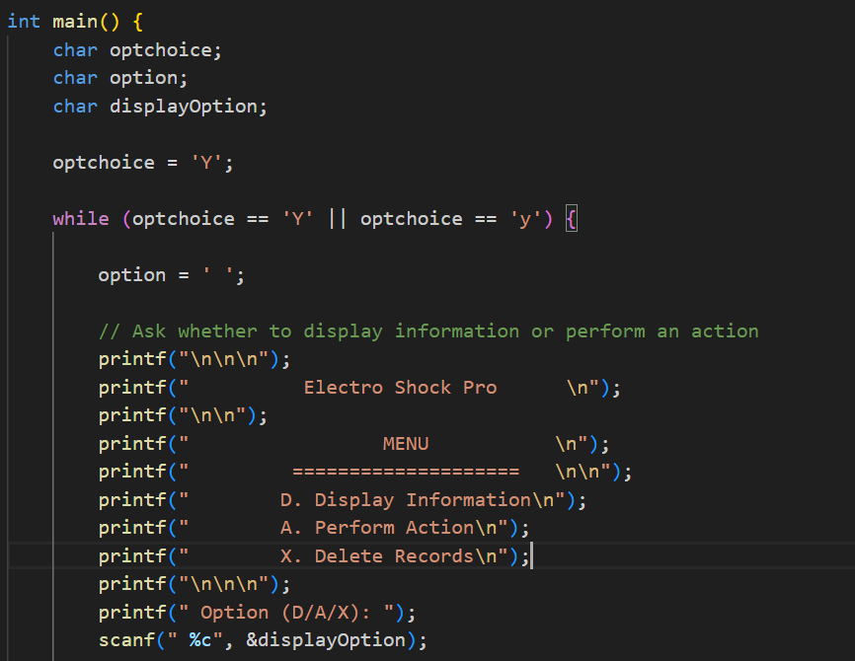
Code Implementation
Our Inventory management will include features for adding, displaying, and deleting data of Inventory products, customers, Suppliers, sale, and purchase data.
The Display function provides a comprehensive overview of inventory, customers, suppliers, and transactions.
Perform action enables record addition and transaction logging for seamless data management.
Delete facilitates the removal of specific records, ensuring system accuracy. Together, they empower users to efficiently navigate and manage the inventory system. These functions collectively contribute to a dynamic and responsive inventory management experience.

Slide 5
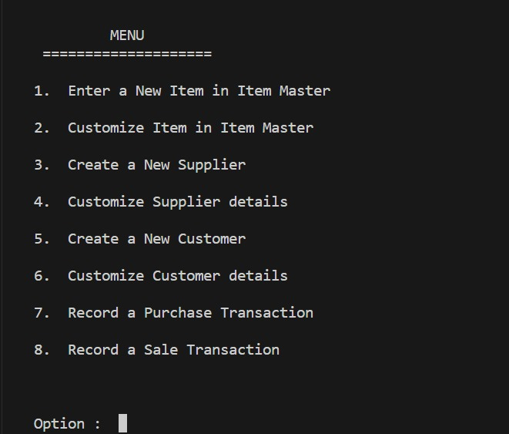
Perform ACTION
The "Perform Action" option, a pivotal component within the electronic shop management system, encompasses an array of functions designed for efficient business control. Among these functions are createItem(), createSupplier(),createCustomer(), recordPurchaseTransaction(),and recordSaleTransaction().
These functions enable users to seamlessly create new records for items, suppliers, customers, and transactions, contributing to the dynamic management of the electronic shop.The option also integrates robust reporting mechanisms facilitated by functions such as displayInventory(),create_report_item(),create_report_ supplier(), create_report_customer(), create_report_PurchaseTransaction(), and create_report_SaleTransaction().
These functions generate detailed reports, offering valuable insights into inventory trends, supplier interactions, customer preferences, and transaction histories, thereby empowering informed decision-making.

Slide 6
Code Implementation
int createitem();
int createsupplier();
int createCustomer();
int recordPurchaseTransaction();
int recordSaleTransaction();
The functions createItem(), createSupplier(), createCustomer(), recordPurchaseTransaction(), and recordSaleTransaction() are integral components of the electronic shop management system. createItem() and createSupplier() facilitate the addition of new items and suppliers, while createCustomer() enables the incorporation of new customer details. recordPurchaseTransaction() and recordSaleTransaction() contribute to the real-time tracking of purchase and sale transactions, enhancing the system's ability to manage inventory and customer interactions effectively.

Slide 7
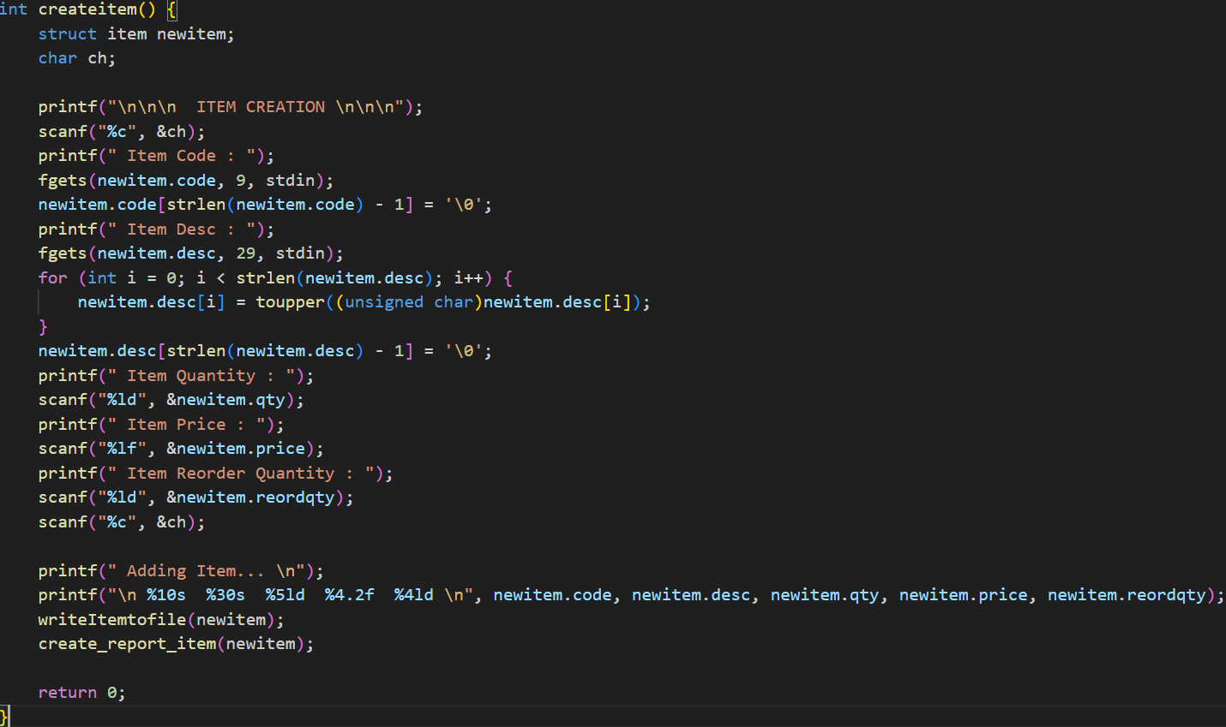
Item Creation (int createitem())

Slide 8
Creating Items
The createitem function serves the purpose of facilitating the creation of a new inventory item. It guides the user through the input of essential item details, including the item code, description, quantity, price, and reorder quantity.
The function incorporates input handling mechanisms, such as using fgets to prevent buffer overflow and converting the item description to uppercase.
Following user input, the function prints a formatted table displaying the details of the newly created item. Subsequently, it invokes two functions: writeItemtofile for writing the new item to a file, presumably updating the item inventory, and create_report_item for generating a report, possibly for record-keeping purposes. The function concludes by returning 0, signifying successful item creation.
Additionally, the function employs the scanf and fgets functions for user input, ensuring a structured and controlled means of gathering information. It includes necessary conversions, such as transforming the item description to uppercase using a loop.

Slide 9
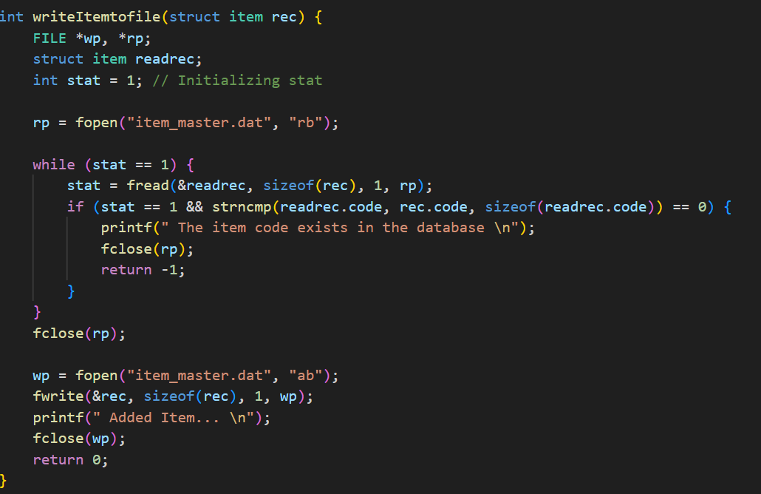
Adding records to file

Slide 10
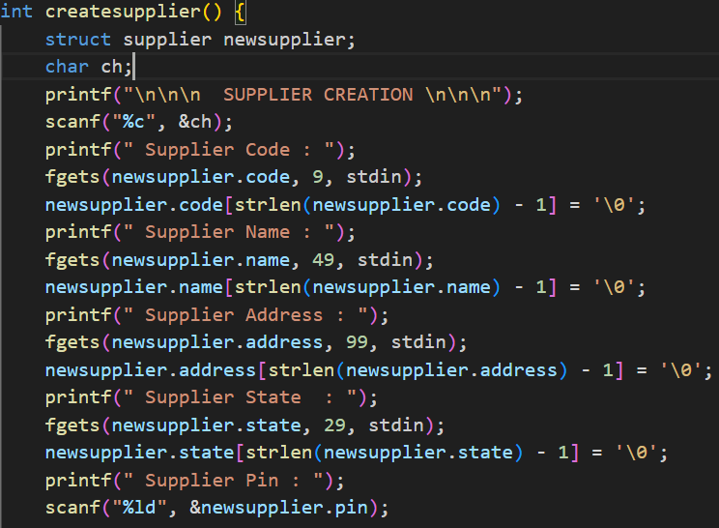
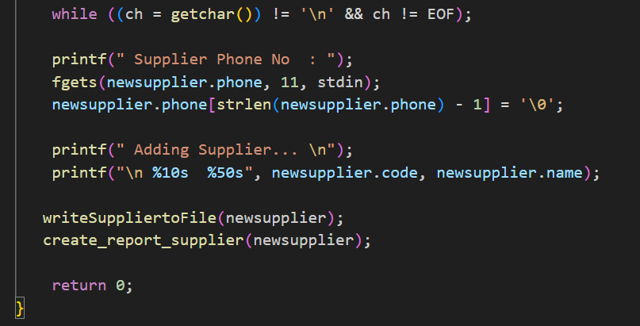
Supplier Details int createsupplier();
The createsupplier() function facilitates the creation of a new supplier by gathering essential information from the user. It utilizes fgets and scanf functions to input details such as the supplier code, name, address, state, pin, and phone. To ensure data integrity, the function includes a buffer-clearing mechanism.
Upon gathering the supplier details, the function signals the addition of the supplier and proceeds to execute functions:writeSuppliertoFile(newsupplier) and create_report_supplier(newsupplier). The former records the supplier's information in a file, while the latter generates a summary report for the newly added supplier.

Slide 11
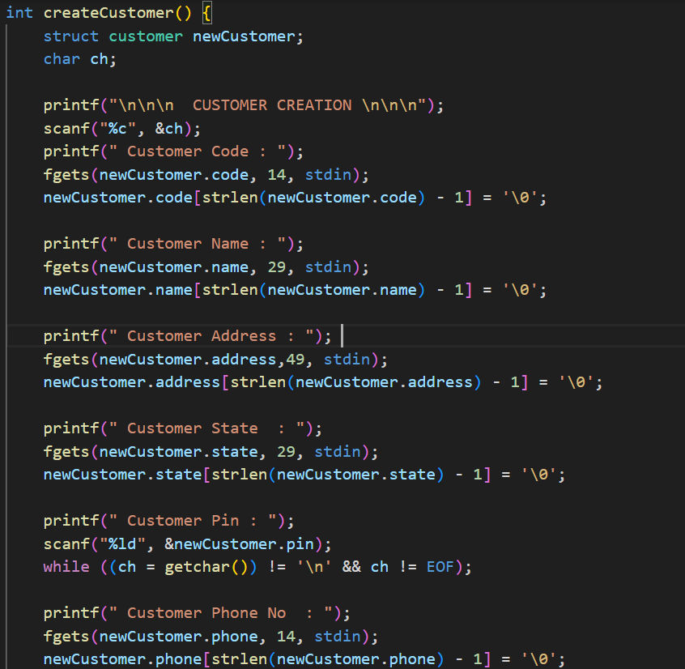
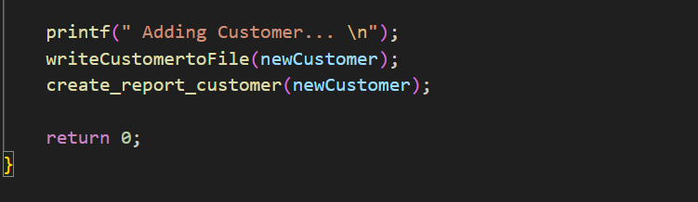
Customer Details ( int createcustomer();)

Slide 12
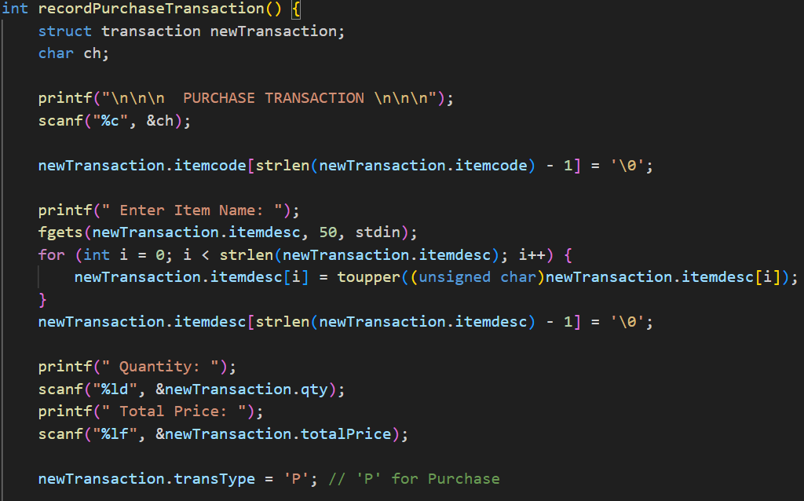
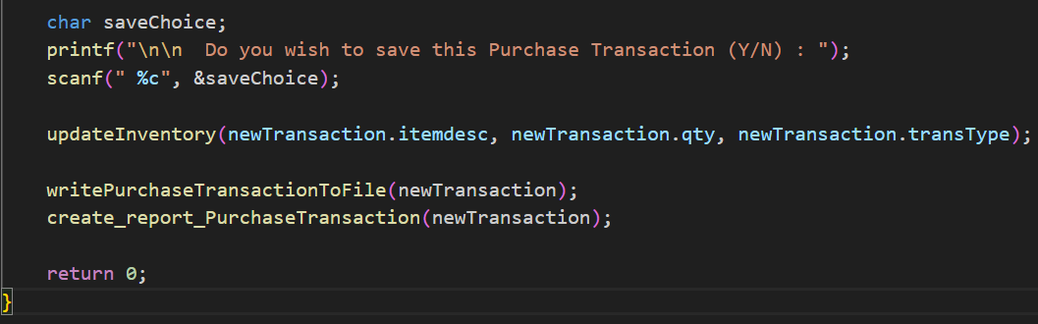
Purchase Transaction ( int recordPurchaseTransaction() )
The recordPurchaseTransaction() function facilitates the entry of a new purchase transaction into the system. It guides the user through inputting essential details such as the item name, quantity, and total price.
The function then sets the transaction type to 'P' to signify a purchase. The user is prompted to confirm whether they want to save the transaction, and subsequently, the inventory is updated using the updateInventory() function.
Finally, the details of the purchase transaction are stored in a file, and a purchase transaction report is generated through the writePurchaseTransactionToFile() and create_report_PurchaseTransaction() functions, respectively.

Slide 13
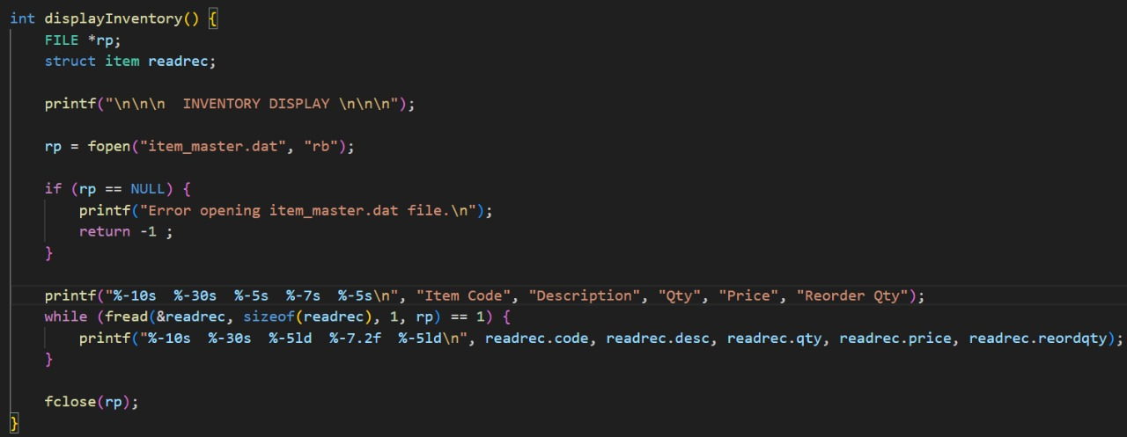
DISPLAYING RECORDS

Slide 14
The displayInventory function plays a crucial role in presenting a comprehensive overview of the electronic shop's current inventory. It establishes a connection to the "item_master.dat" file using file input operations, allowing it to retrieve stored information about various items. The function adeptly organizes and exhibits key details such as item code, description, quantity, price, and reorder quantity.
Upon initiation, the function meticulously attempts to open the "item_master.dat" file in binary read mode. If any issues arise during this process, it promptly responds by printing an error message, signaling a potential problem, and returns -1 to signify an unsuccessful operation.
After a successful file opening, the function proceeds to present a structured header, featuring column labels for clarity and coherence. Subsequently, it enters a systematic loop, iterating through each item record within the file. During each iteration, it reads and extracts the relevant details before showcasing them in a neatly formatted table.
The loop continues until the function reaches the end of the file, ensuring that all items are accurately displayed in the final output.

Slide 15
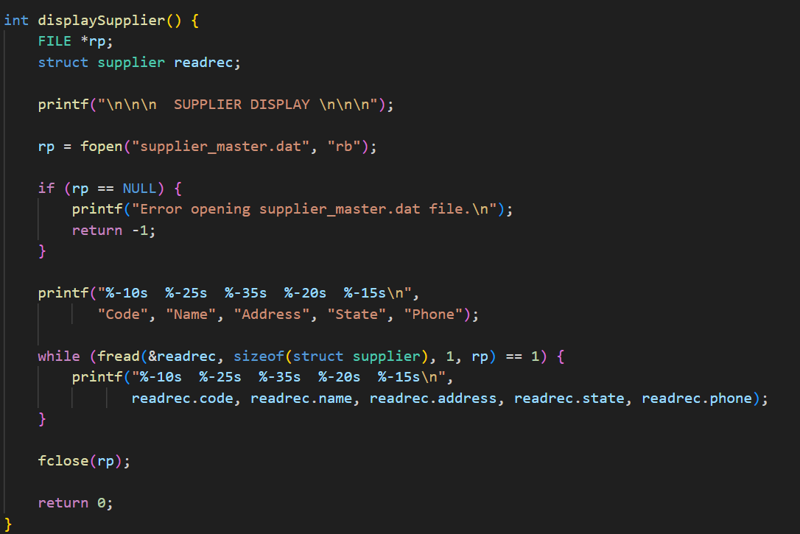
Supplier Display

Slide 16
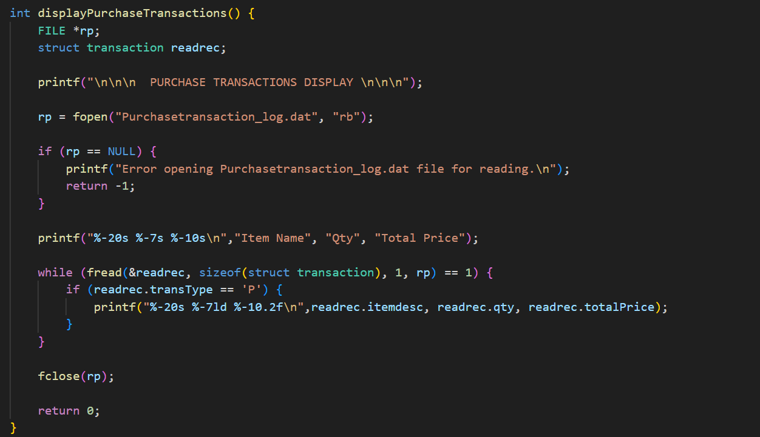
Purchase Transaction Display

Slide 17
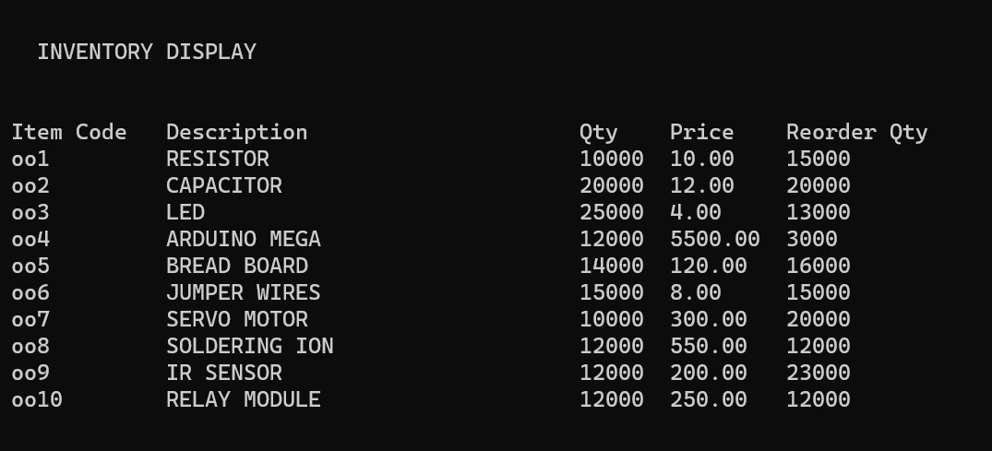
Displaying Results
1. Inventory Display

Slide 18
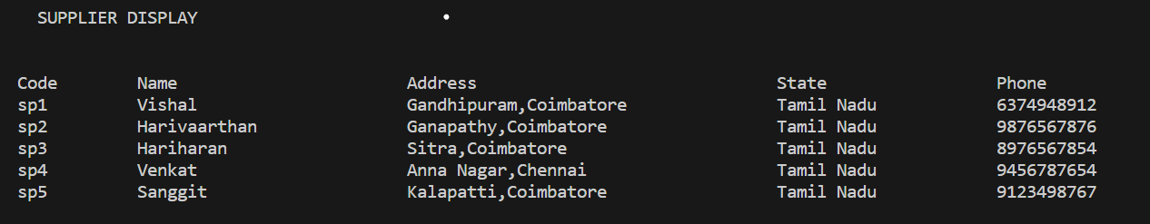
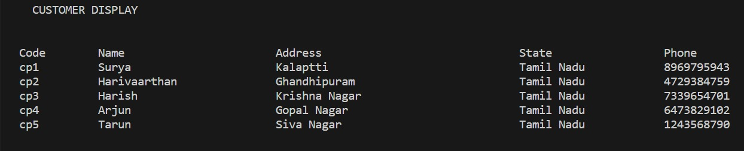
2. Supplier Display
3. Customer Display

Slide 19
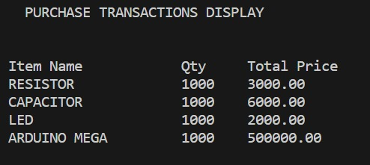
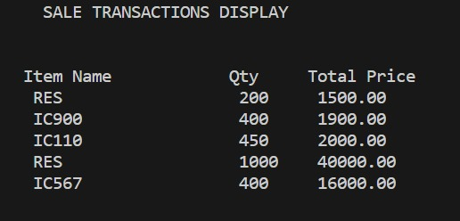
4 Purchase Transactions Display
5. Sale Transactions Display

Slide 20
Customizing records
void customizeitem();
void customizeSupplierDetails();
void customizeCustomerDetails();
The customizeitem(), customizeSupplierDetails(), and customizeCustomerDetails() functions serve as integral components within a system, allowing users to modify specific details related to items, suppliers, and customers, respectively. In customizeitem(), users input an item code and choose between modifying all details or specific attributes such as name, description, quantity, price, and reorder quantity.
The function ensures the accurate reflection of changes in the data storage. Similarly, customizeSupplierDetails() and customizeCustomerDetails() operate on supplier and customer information, respectively, offering customization options for various details like name, address, phone number, code, pin, and state. These functions play a pivotal role in maintaining data accuracy and integrity, providing a controlled and user-friendly mechanism for updating crucial information within the system.

Slide 21
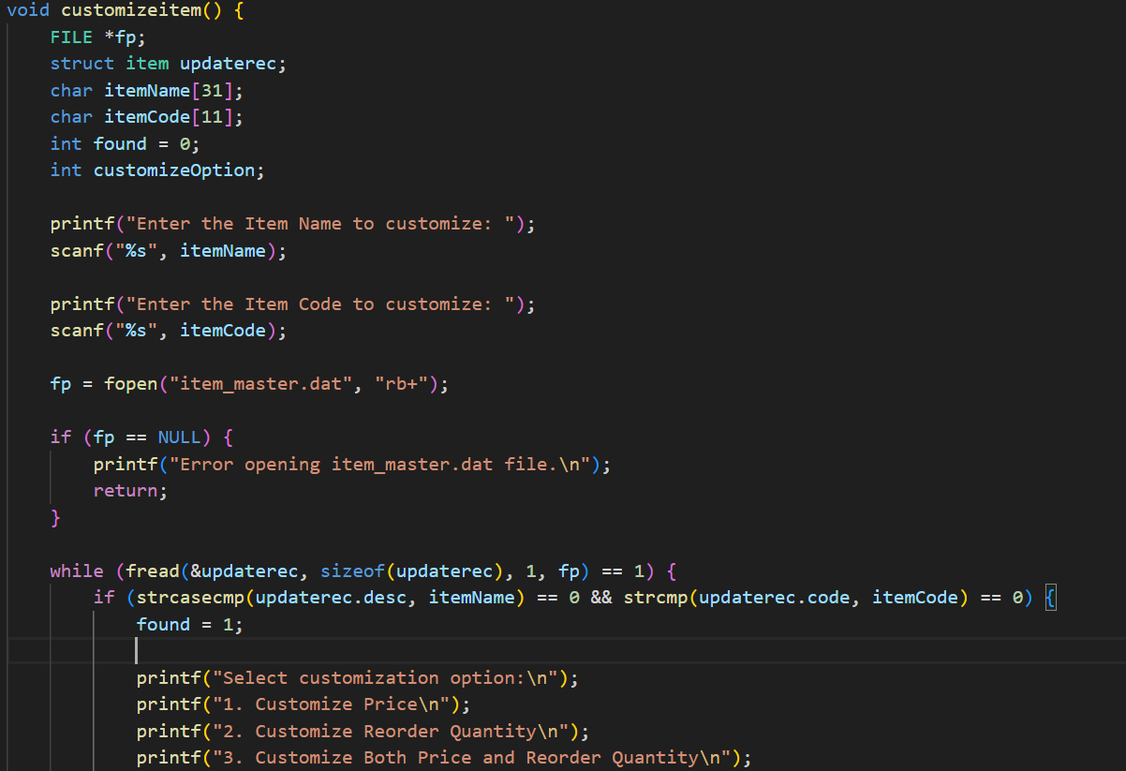
Customizing records (void customizeitem() )
The customizeitem function is designed to modify specific attributes of an item in the inventory. It begins by prompting the user to input the item name and code, searching for a matching record in the "item_master.dat" file. The search is case-insensitive, providing flexibility in user input.
Upon finding the item, the function presents a menu of customization options, such as updating the price, reorder quantity, or both. The user's choice is processed using a switch statement, allowing for the execution of the corresponding customization task.

Slide 22
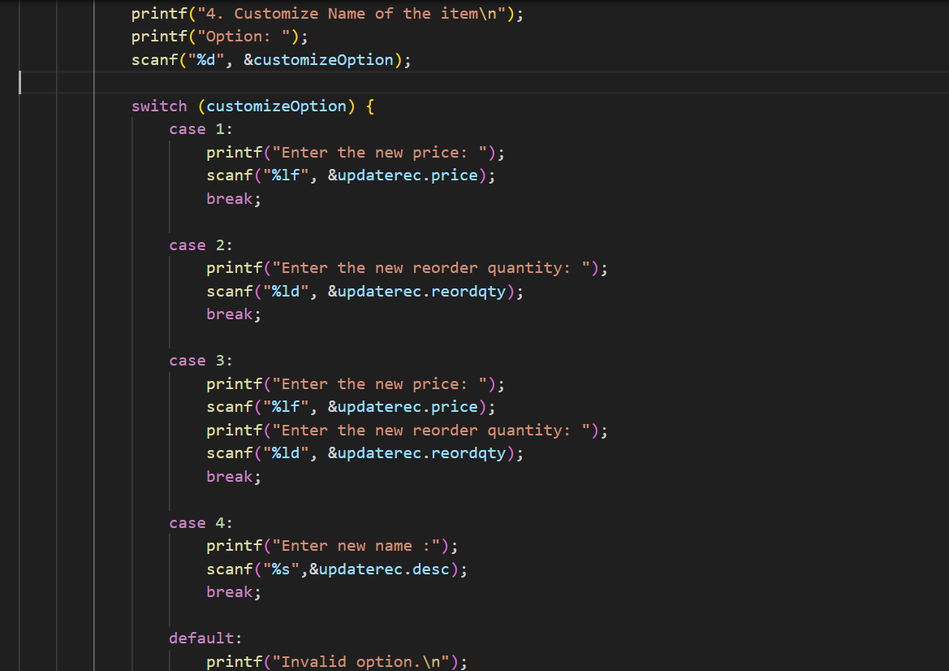
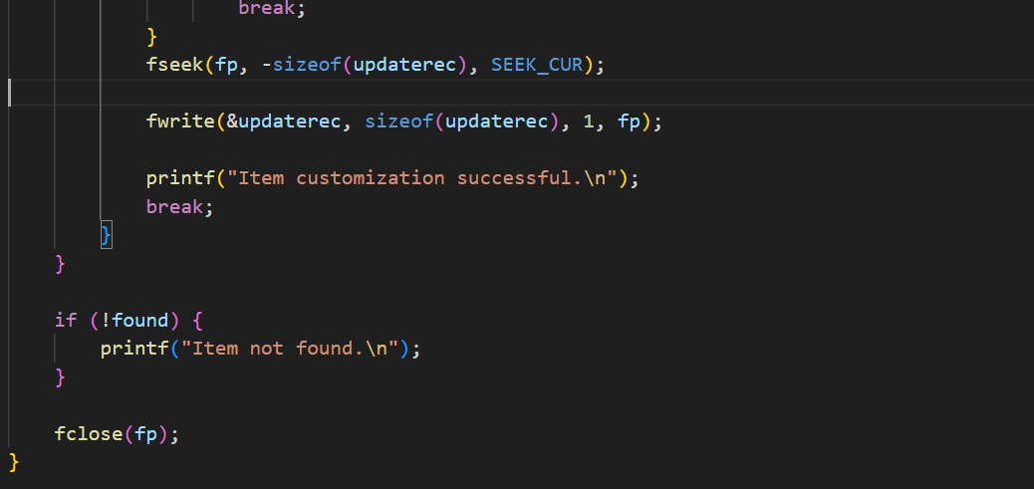
If the user selects to customize the price, they are prompted to enter the new price, updating the price attribute of the item. Similarly, for customizing reorder quantity, the user provides the new reorder quantity, updating the reordqty attribute. If the user chooses to customize both price and reorder quantity, they are prompted for both inputs.
The function includes an option to customize the name of the item. The user is prompted to enter the new name (desc attribute), and the function updates the record accordingly.
After customization, the function moves the file cursor back to the beginning of the record and writes the updated record back to the file. Finally, it notifies the user of the successful item customization.

Slide 23
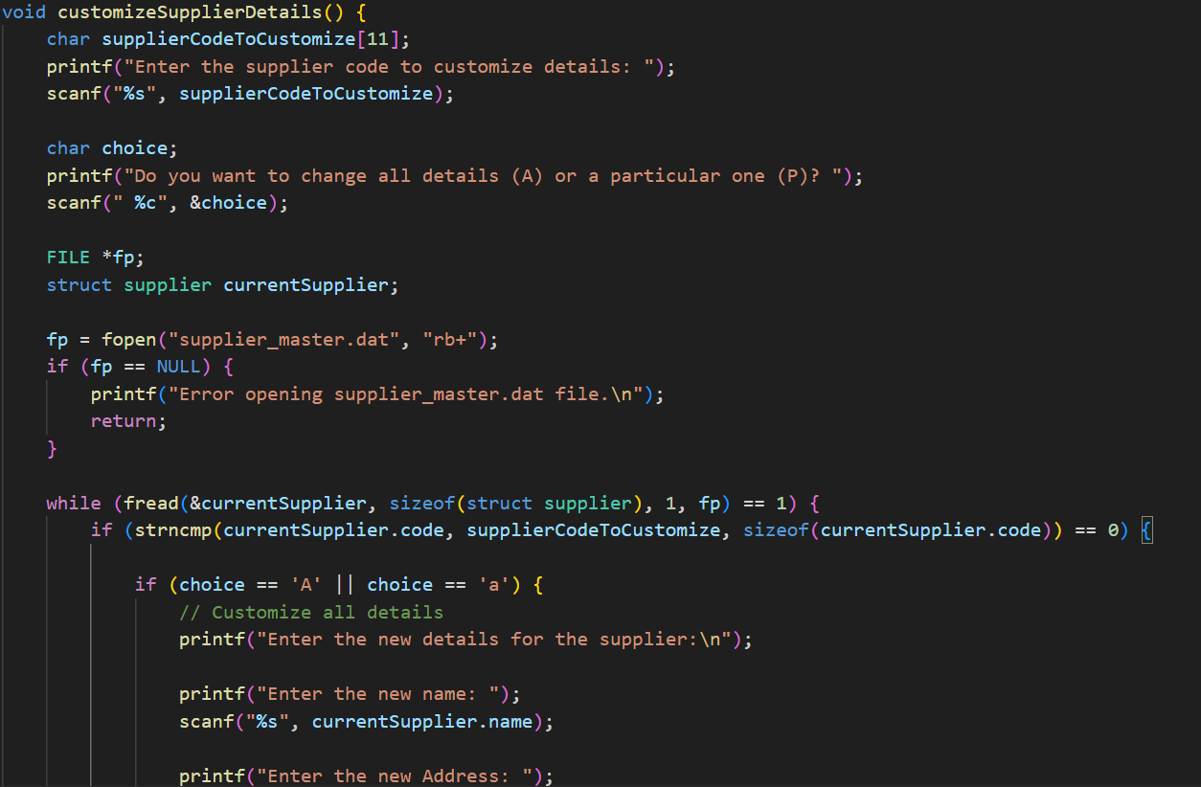
The customizeSupplierDetails() function is an integral part of an electronic shop management system, offering users the ability to modify and update supplier information as needed. The process begins with the user entering the supplier code for the record they wish to customize. Additionally, the user specifies whether they want to modify all details or focus on a specific aspect.
The function then attempts to open the "supplier_master.dat" file, which holds supplier information, in read-write mode. As the function iterates through the supplier records in the file, it compares the entered supplier code with the codes in the records. If a match is found, the customization process is initiated.

Slide 24
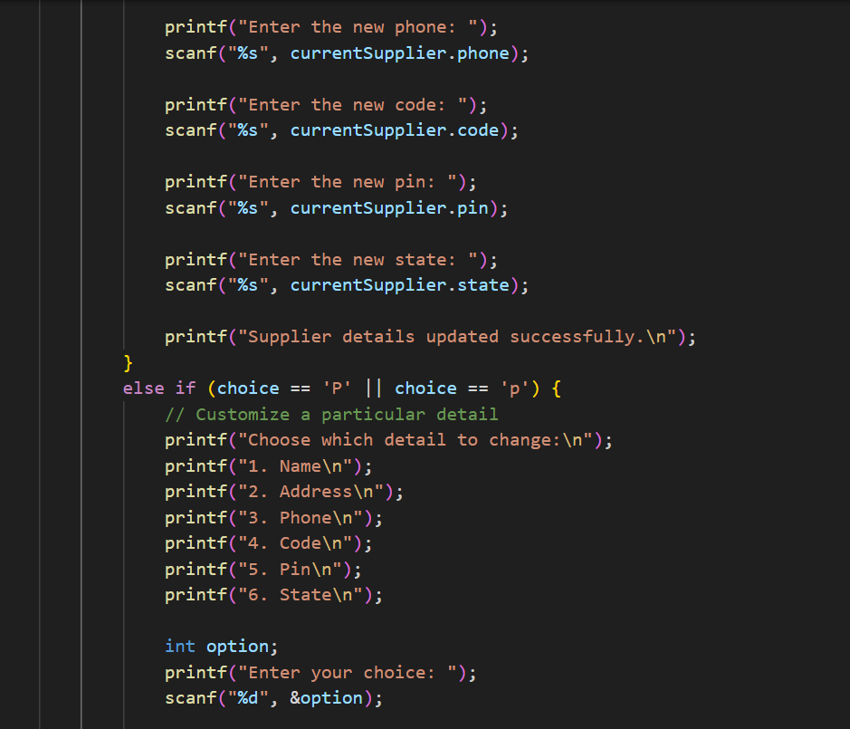
Users can either update all details, including name, address, phone, code, pin, and state or choose to modify a particular aspect by selecting from a menu.
The function ensures a user-friendly experience by providing clear prompts and menus for customization choices. After obtaining the new information, it updates the corresponding fields in the supplier record and writes the changes back to the file. The use of file manipulation functions like fseek and fwrite ensures that modifications are accurately applied.
In the event that the supplied supplier code is not found, the function communicates this to the user, preventing unintended modifications. This robust feedback mechanism enhances the reliability of the system, giving users confidence in the accuracy of their interactions.

Slide 25
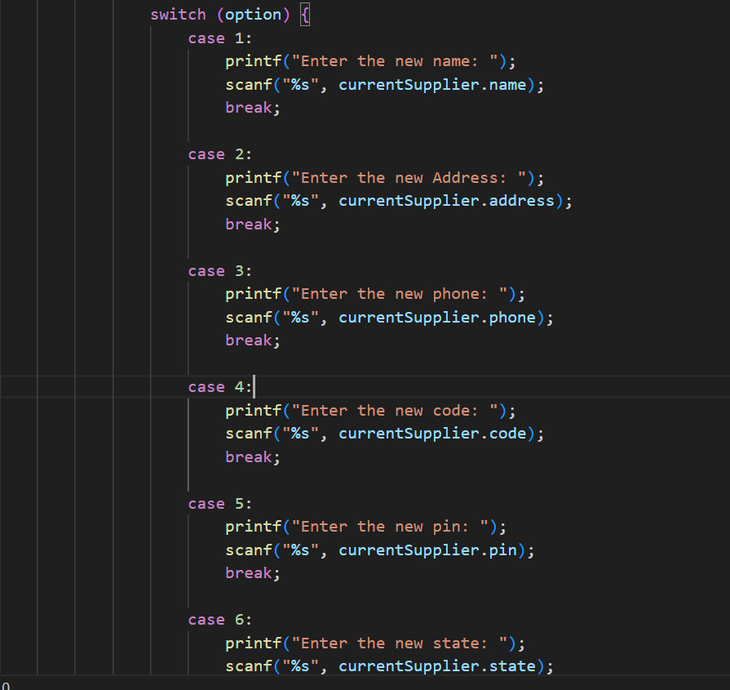
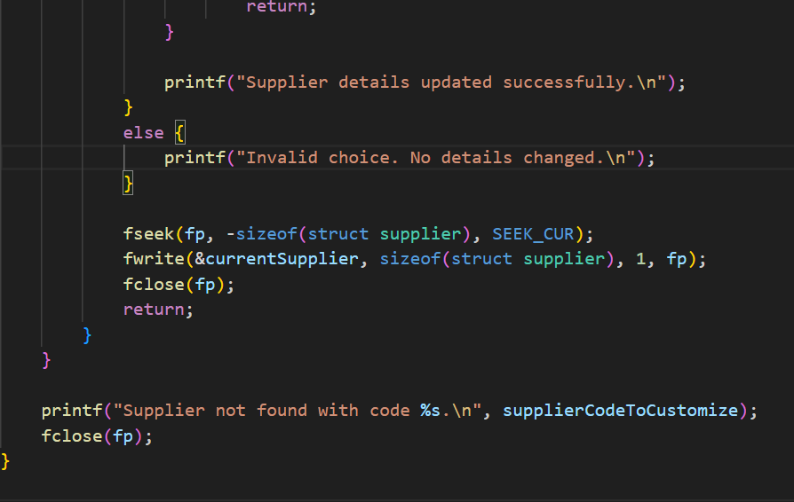
The function seeks to the precise position within the supplier file where the current supplier's details are stored, ensuring that modifications are applied to the correct record. The subsequent call to fwrite() guarantees that the updated supplier information is accurately written back to the file.
Overall, customizeSupplierDetails() stands out as a versatile and interactive tool, crucial for maintaining an up-to-date supplier database within the electronic shop management system.

Slide 26
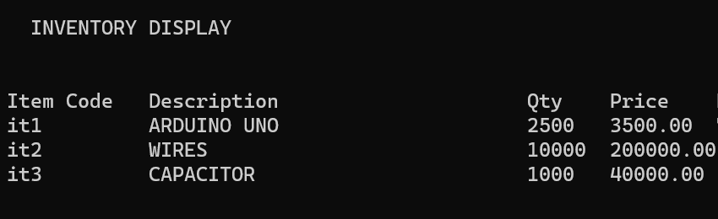
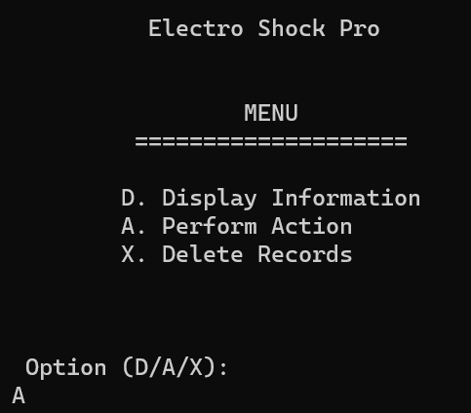
Customizing records
The `customizeitem` function empowers users to personalize specific details of an item stored in the system. It initiates by prompting the user to input the item code for identification.
Following this, users are presented with a choice between modifying all details (A) or a specific one (P). If the user opts for customization of all details, the function guides them through the process of entering new information for the description, price, and reorder quantity.
In case the user chooses to customize a particular detail, a menu is presented, allowing the selection of the specific detail to modify. Upon receiving the new details, the function updates the item information, prints a success message, and employs file I/O operations to update the "item_master.dat" file.
The process involves searching for the item with the specified code, moving the file pointer to the relevant position, and writing the new information to the file.

Slide 27
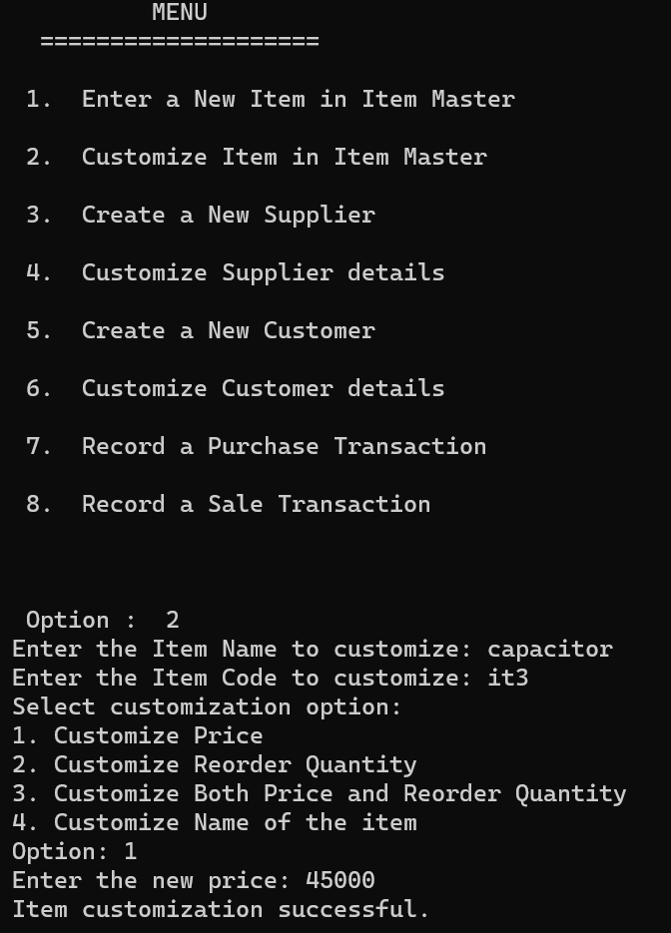
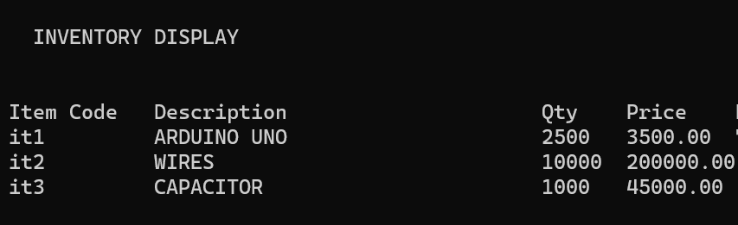
In the Initial Inventory, the price of the capacitor was 40000, by accessing the customize item option the price has been modified to 45000.
The customization process involves user interaction, where they input the desired modifications for the chosen item. In this example, the price was specifically altered. The system then internally updates the corresponding item record in the storage file, reflecting the changes made by the user.
After successful customization, a confirmation statement is displayed, ensuring users are informed about the successful execution of the customization process.
In summary, the "customizeitem" function empowers users to adapt and personalize item details, contributing to a flexible and user-centric electronic shop management system.

Slide 28
Deleting records
int deleteItem();
int deleteSupplier();
int deleteCustomer();
int deletePurchaseTransaction();
int deleteSaleTransaction();
The functions deleteItem(), deleteSupplier(), deleteCustomer(), deletePurchaseTransaction(), and deleteSaleTransaction() are vital components of a system designed to manage and maintain data integrity. Each function targets a specific entity—item, supplier, customer, purchase transaction, and sale transaction—providing users with the capability to remove outdated or unnecessary records from the system. These functions typically prompt users to input identification codes or other relevant information to pinpoint the specific record to be deleted.
Subsequently, the functions ensure the accurate removal of the identified data from the corresponding data storage, contributing to the overall efficiency and organization of the system by allowing users to keep their databases updated and relevant.

Slide 29
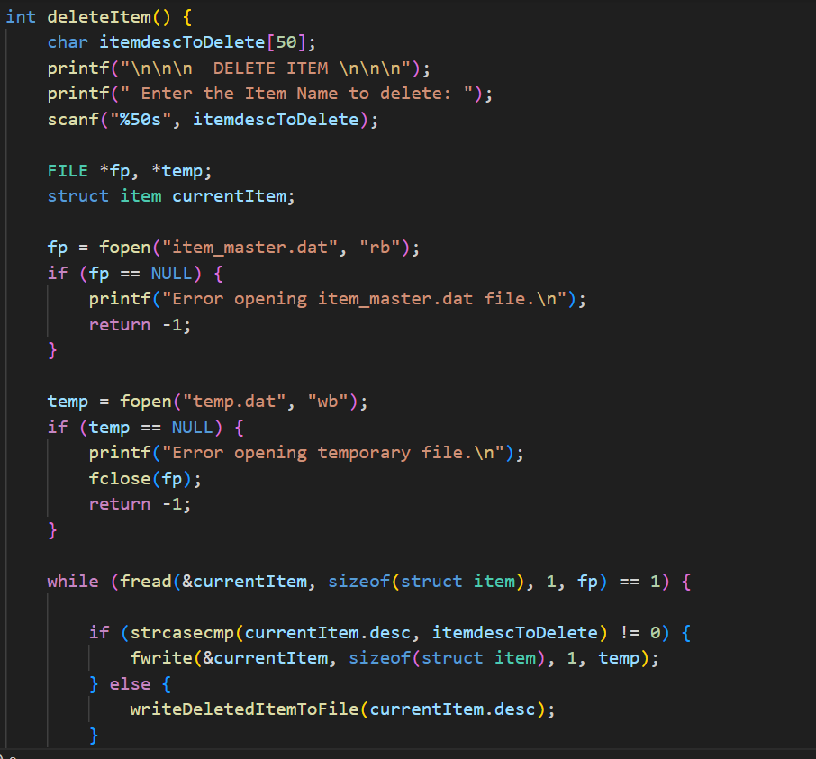
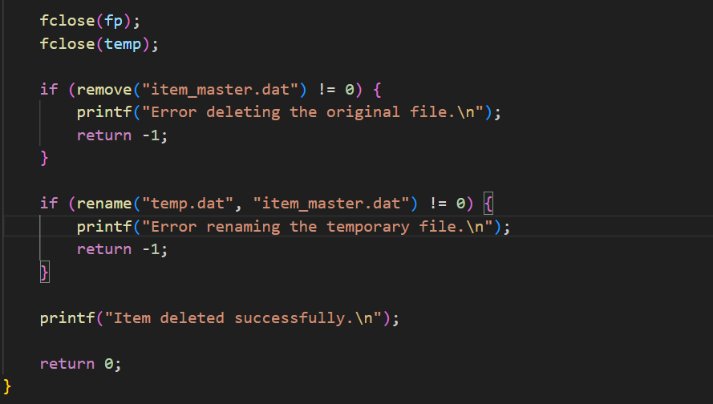
The deleteItem() function facilitates the removal of a specific item from the system. Upon user input of the item name to be deleted, the function opens the "item_master.dat" file and a temporary file ("temp.dat").
It reads through the existing items, copying each to the temporary file except for the one matching the specified item name. Simultaneously, the function writes the details of the deleted item to another file using the writeDeletedItemToFile function.
After successfully processing the items, the function closes both files and proceeds to replace the original "item_master.dat" file with the temporary file, effecting the deletion. The function provides error handling for file operations, notifying users in case of any issues.

Slide 30
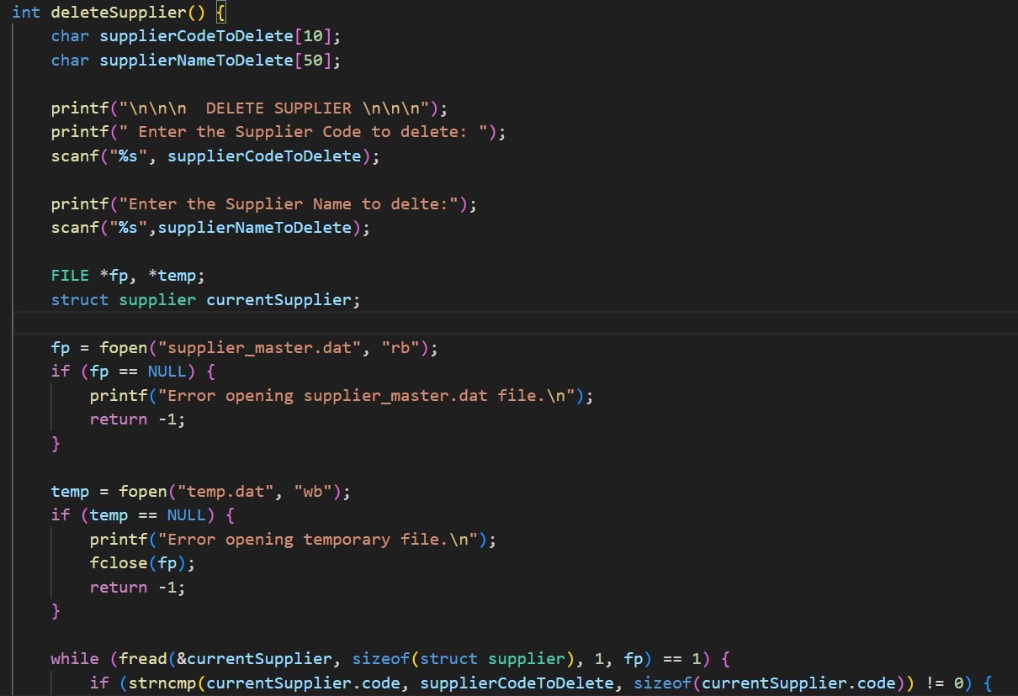
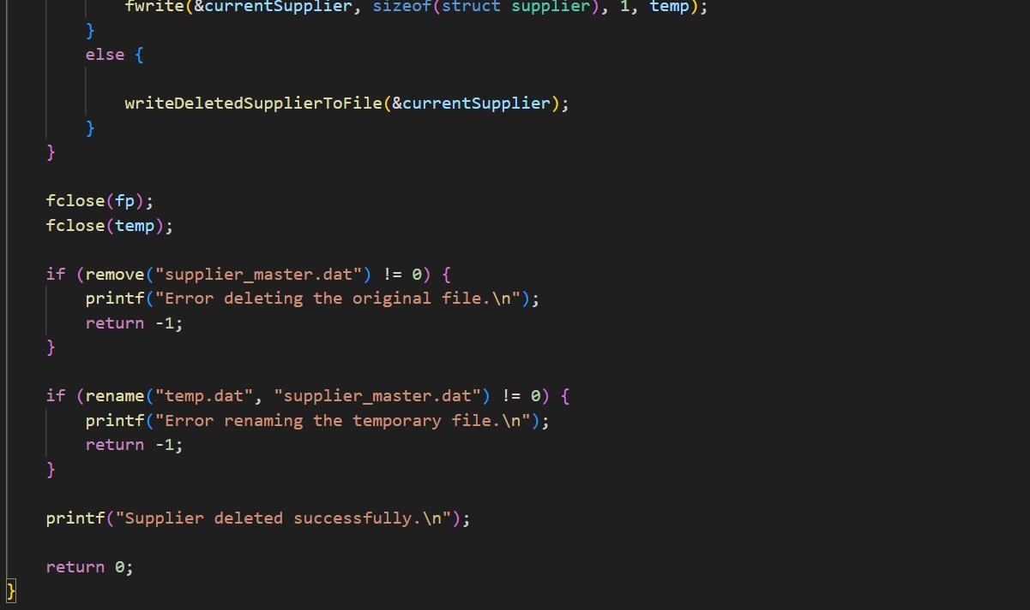
The deleteSupplier() function is designed to remove a supplier from the electronic shop system based on the provided supplier code and name. The user is prompted to input the supplier code and name of the supplier to be deleted. The function then opens the supplier file (supplier_master.dat) in read mode and a temporary file (temp.dat) for writing.
While reading each supplier record from the original file, the function checks if the supplier code matches the one specified for deletion. If there is a match, the supplier record is not written to the temporary file, but instead, the details of the deleted supplier are recorded using the writeDeletedSupplierToFile() function. If no match is found, the supplier record is written to the temporary file.
After processing all supplier records, the original supplier file is removed, and the temporary file is renamed to replace the original file, effecting the deletion of the specified supplier. Informative messages are displayed to indicate the success or failure of the deletion process

Slide 31
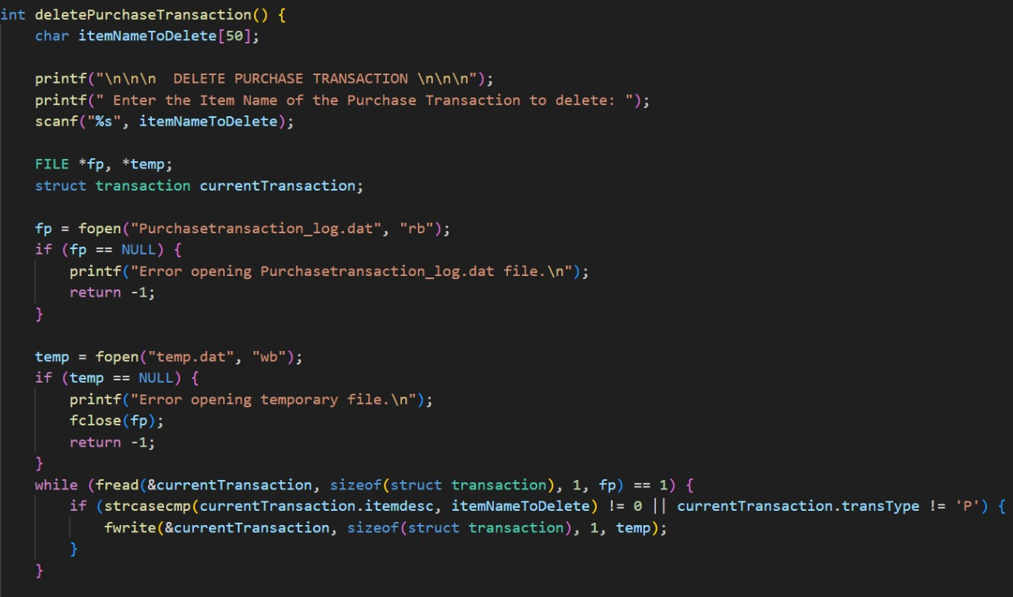
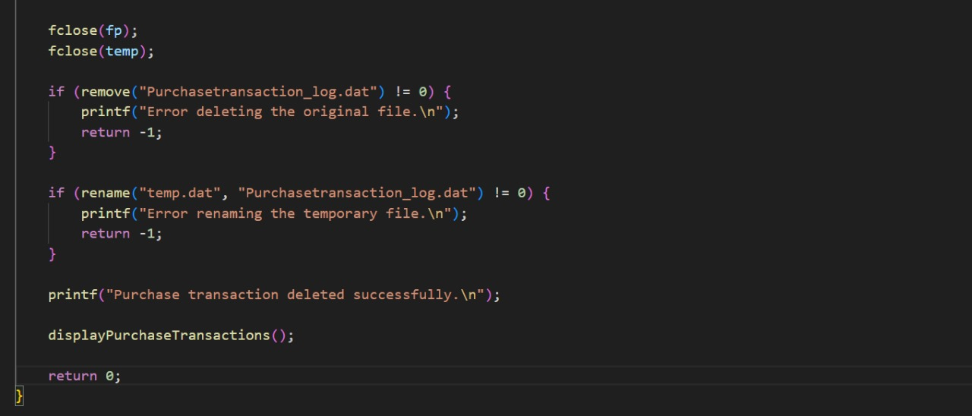
The deletePurchaseTransaction() function is intended to remove a purchase transaction record from the electronic shop system based on the provided item name. The user is prompted to input the item name associated with the purchase transaction to be deleted. The function then opens the purchase transaction log file(Purchasetransaction_log.dat) in read mode and a temporary file (temp.dat) for writing.
While reading each transaction record from the original file, the function checks if the item name does not match the one specified for deletion or if the transaction type is not 'P' (indicating a purchase transaction). If these conditions are met, the transaction record is written to the temporary file.
The function concludes by calling displayPurchaseTransactions() to present an updated list of purchase transactions, providing the user with visual confirmation of the deleted transaction and ensuring transparency in the system's state.

Slide 32
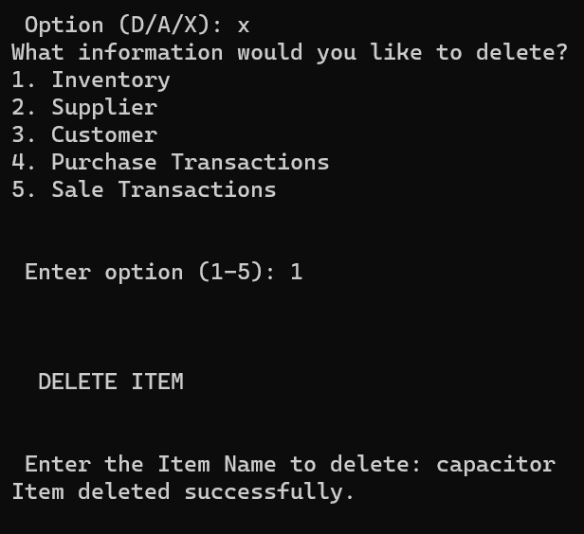
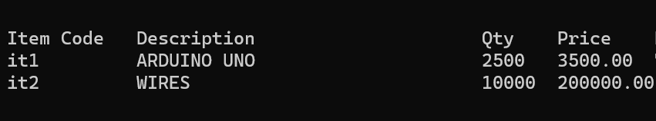
Deleting results
The deletion of the item named "capacitor" from the inventory has been successfully executed. This action was initiated through the "deleteItem" function, where users were prompted to enter the name of the item they wished to remove.
The system efficiently located and deleted the specified item, ensuring that the inventory reflects the most accurate and up-to-date information.
As a result, the electronic shop's inventory is now updated, and the "capacitor" is no longer present in the item list. The successful deletion is confirmed through a system-generated message, providing users with assurance regarding the completion of the delete operation.

Slide 33

THANK YOU

